Slide 1
CNN Transfer Learning
Presenters: Happy & Grace

Slide 2
01
CNN Transfer Learning Method
CONTENTS
02
CNN Architectre Review
03
Transfer learning with VGG16
04
Evaluation Metrics
05
InceptionNet
06
Assignment 3

Slide 3
01
CNN Transfer Learning Method

Slide 4
01
CNN Transfer learning using pretrained model
The process of leveraging knowledge from pre-trained models on large datasets and applying it to new tasks with limited data.
Transfer Learning gives us the ability to share learned features across different learning tasks.
Benefits of using pre-trained models:
Faster convergence
Improved generalization
Ability to leverage pre-learned features

Slide 5
CNN Architecture Review
02

Slide 6
CNN Architectures
02
LeNet
AlexNet
VGGNet (VGG 16 and VGG 19)
ResNet
InceptionNet
MobileNet
EfficientNet, etc

Slide 7
03
Transfer Learning with VGG 16

Slide 8
Transfer Learning with VGG16
03
Using a pre-trained VGG model as a feature extractor for a new task.
Pre-trained models have learned rich representations from vast datasets, which can be beneficial for new tasks with limited data.
Removing the original fully connected layers and adding new ones suitable for the new task.
The original VGG fully connected layers are designed for the ImageNet classification task, so they need to be replaced for the new task in order to achieve optimal performance

Slide 9
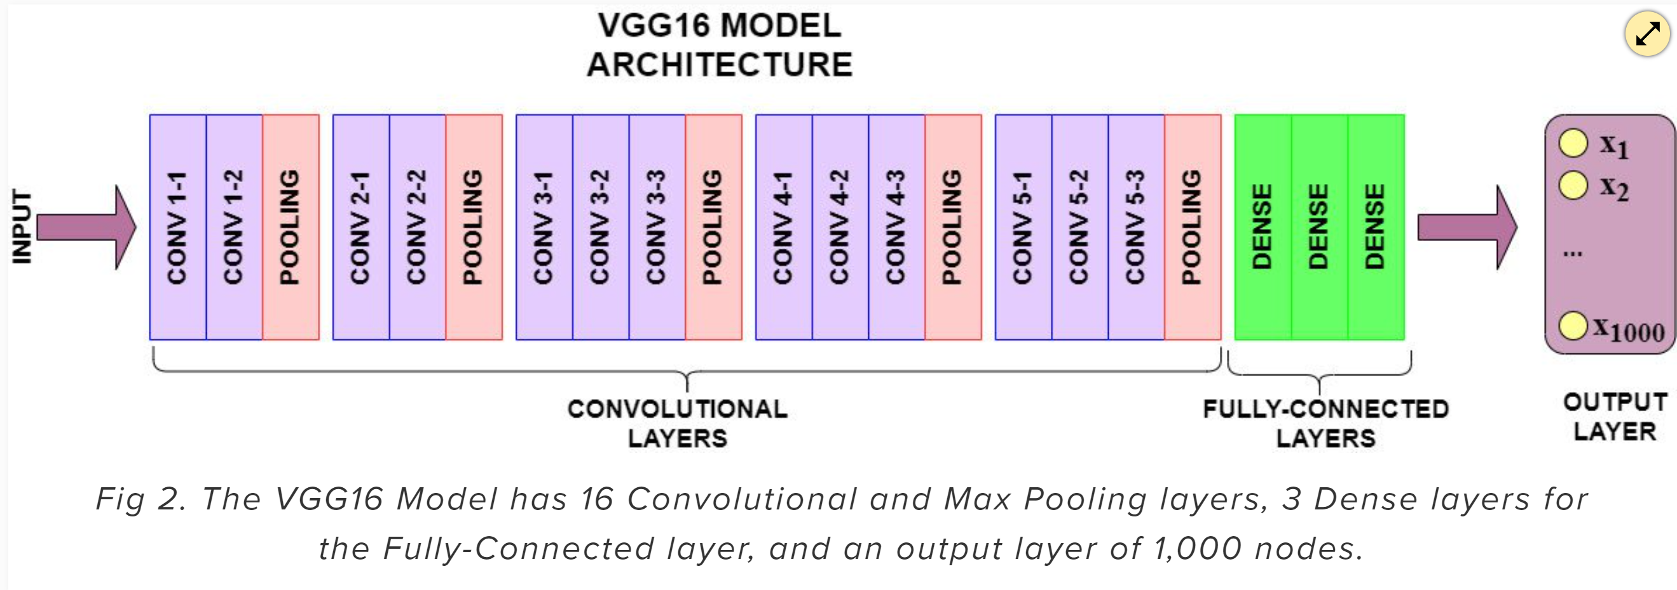
Transfer Learning with VGG16
03
For more explanation, read more with this link: https://www.learndatasci.com/tutorials/hands-on-transfer-learning-keras/

Slide 10
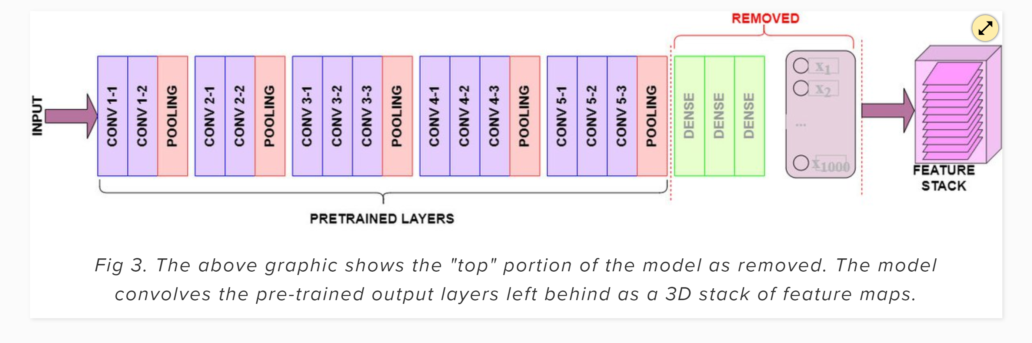
Transfer Learning with VGG16
03
For more explanation, read more with this link: https://www.learndatasci.com/tutorials/hands-on-transfer-learning-keras/

Slide 11
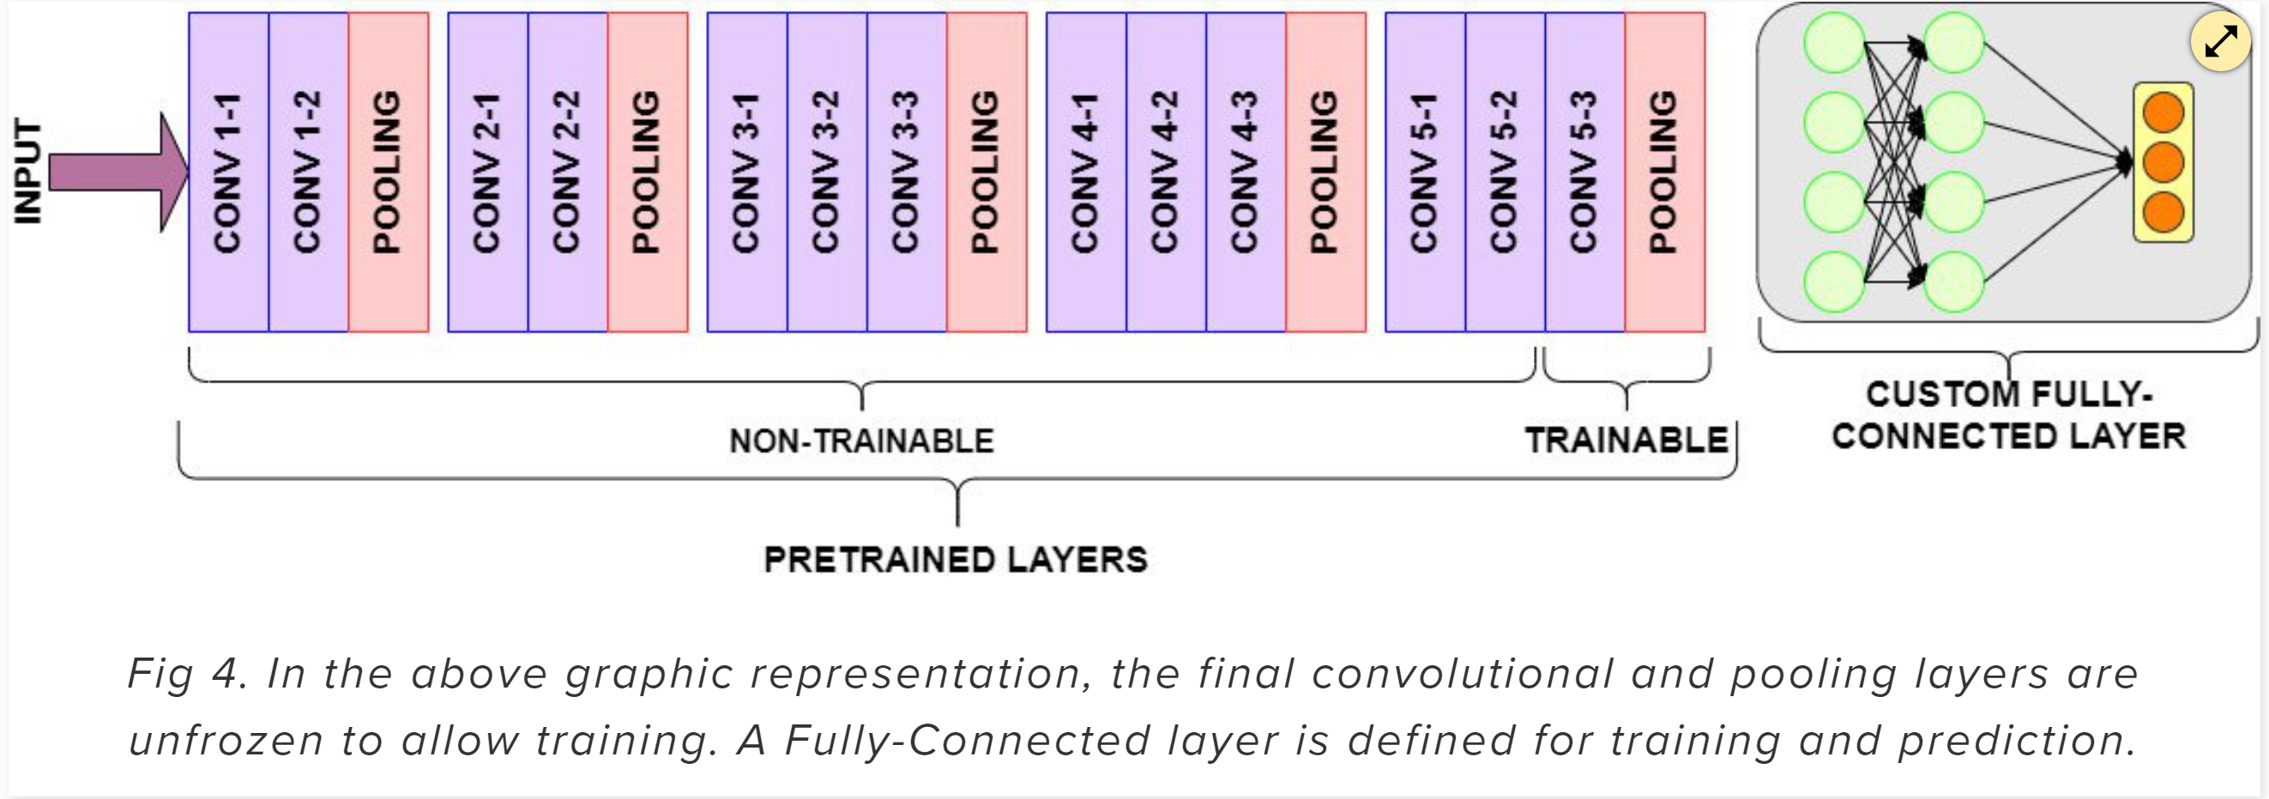
Transfer Learning with VGG16
03
For more explanation, read more with this link: https://www.learndatasci.com/tutorials/hands-on-transfer-learning-keras/

Slide 12
04
Evaluation Metrics

Slide 13
Confusion Matrix
04
The confusion matrix provides a tabular representation of the model's predictions compared to the true labels. It consists of four values:
True Positive (TP): The number of samples that were correctly predicted as positive.
True Negative (TN): The number of samples that were correctly predicted as negative.
False Positive (FP): The number of samples that were incorrectly predicted as positive.
False Negative (FN): The number of samples that were incorrectly predicted as negative.
The confusion matrix helps us understand the performance of the model in terms of correctly and incorrectly classified samples.

Slide 14
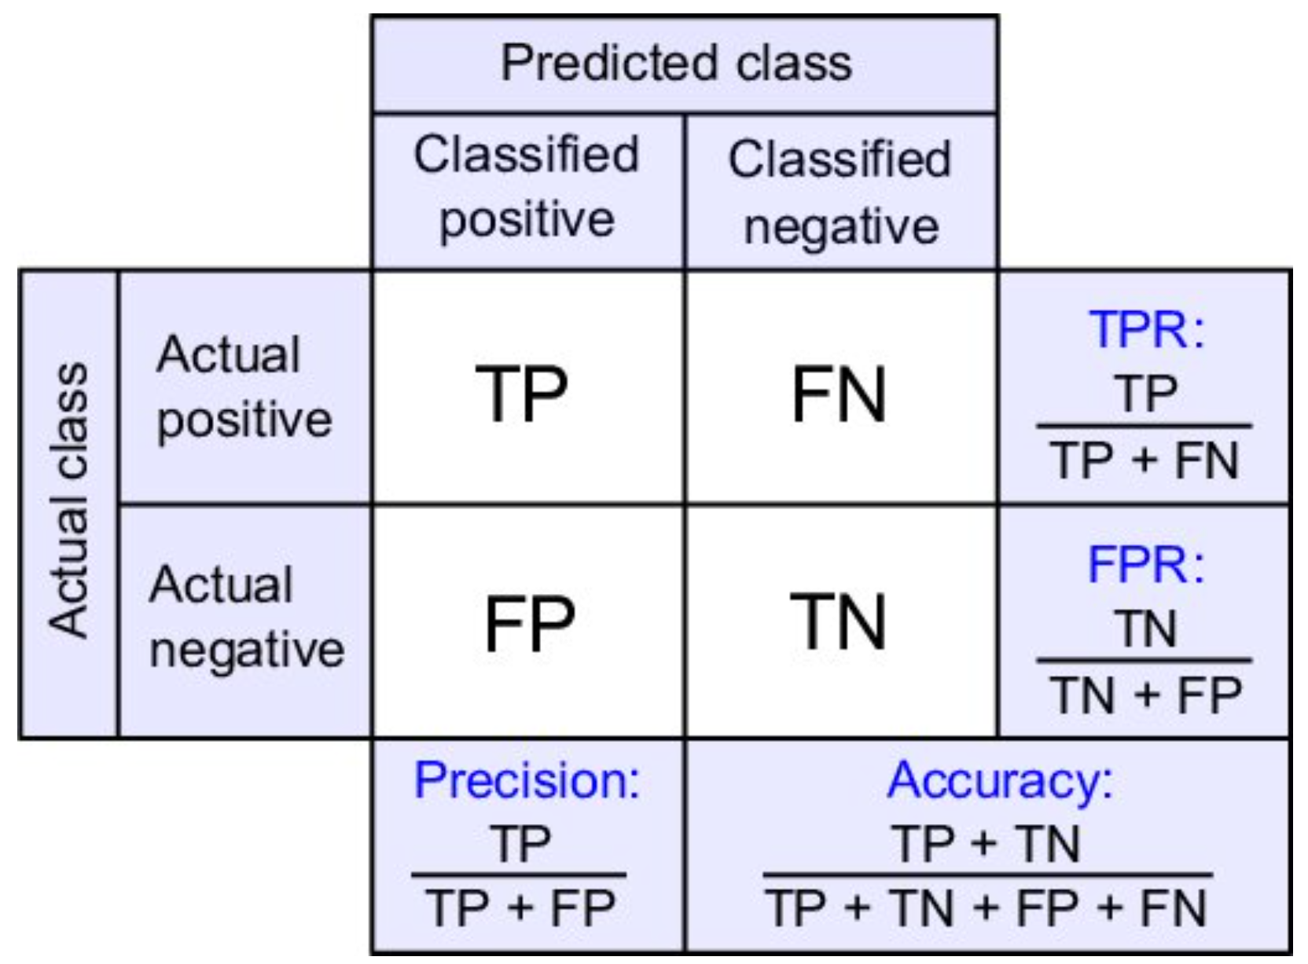
Confusion Matrix
04
Sensitivity

Slide 15
f1-score
04
The F1-score is a single metric that combines precision and recall into a single value. It provides a balanced measure of a model's performance. It is computed as the harmonic mean of precision and recall. The F1-score ranges from 0 to 1, where 1 indicates perfect precision and recall.

Slide 16
Precision-Recall curve
04
The precision-recall curve visualizes the trade-off between precision and recall at various classification thresholds. Precision is the ratio of true positives to the total predicted positives, while recall is the ratio of true positives to the total actual positives. The curve is plotted by varying the classification threshold and computing precision and recall for each threshold. It helps in selecting an appropriate threshold based on the desired precision and recall trade-off.

Slide 17
ROC-AUC (Receiver Operating characteristic - Area Under Curve) Curve
04
The Receiver Operating Characteristic (ROC) curve is another graphical representation of the model's performance. It shows the trade-off between the true positive rate (sensitivity) and the false positive rate (1 - specificity) at different classification thresholds. The Area Under the Curve (AUC) score quantifies the overall performance of the model. An AUC score of 1 represents a perfect classifier, while a score of 0.5 indicates a random classifier.

Slide 18
Sensitivity & Specificity
04
Sensitivity (also known as true positive rate) measures the proportion of actual positive samples correctly identified as positive by the model. It indicates the model's ability to detect positive samples. Specificity (equal to 1 minus false positive rate) measures the proportion of actual negative samples correctly identified as negative by the model. It indicates the model's ability to avoid false alarms for negative samples.

Slide 19
Evaluation metrics
04
These evaluation metrics help assess the performance of a convolutional neural network (CNN) model in binary classification tasks. Understanding these metrics enables you to evaluate and compare different models, choose appropriate thresholds, and interpret their strengths and weaknesses.

Slide 20
Let’s code together

Slide 21
05
InceptionNet

Slide 22
Inception Network
05
Inception Module is a multi-branch network that use multiple types of filter size in a single image block, which is then concatenated and pass onto the next layer.
Inception Modules are used in Convolutional Neural Networks to allow for more efficient computation and deeper Networks through a dimensionality reduction with stacked 1×1 convolutions.

Slide 23
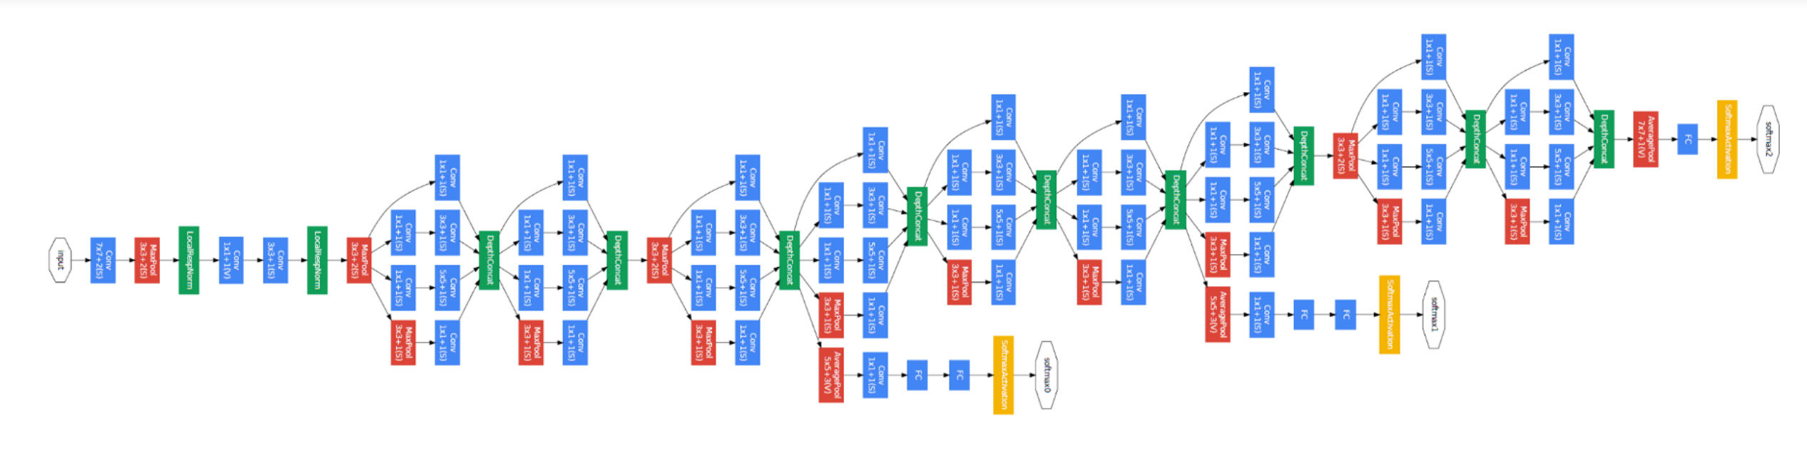
Inception Network
05
The modules were designed to solve the problem of computational expense, as well as overfitting, among other issues.
The solution, is to take multiple kernel filter sizes within the CNN, and rather than stacking them sequentially, ordering them to operate on the same level.

Slide 24
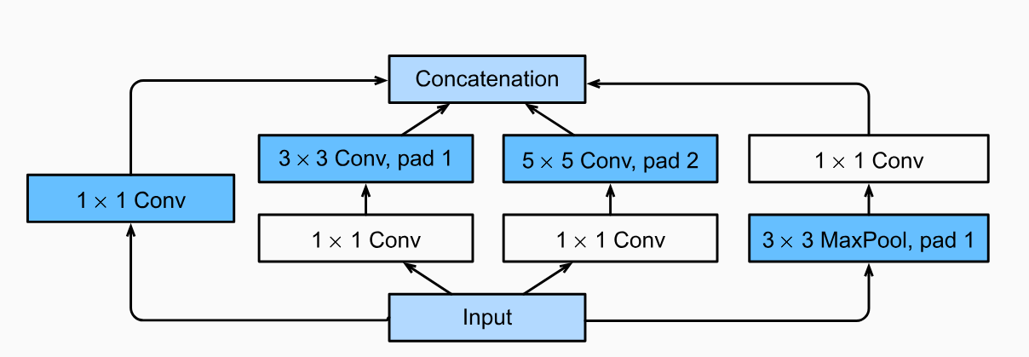
Inception Network
05
To make the process even less computationally expensive, the neural network can be designed to add an extra 1x1 convolution before the 3x3 ad 5x5 layers. By doing so, the number of input channels is limited and 1x1 convolutions are far cheaper than 5x5 convolutions. It is important to note, however, that the 1x1 convolution is added after the max-pooling layer, rather than before.
Fig.1: Inception module with dimension reduction

Slide 25
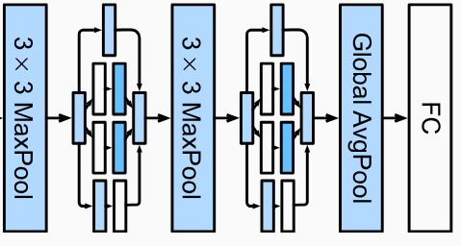

Inception Network
05
2x
2x
A simple Inception Network with a total of 4 inception blocks

Slide 26
Let’s code together

Slide 27
Assignment 3

Slide 28
Assignment 3
06
Send the screenshots of today’s task in the individual group
Deadline: On or before Wedesday Class (28/06/2023)

